Slide 1
Activities and Intents
Day 3

Slide 2
Contents
Activities
Defining an Activity
Starting a new Activity with an Intent
Passing data between activities with extras
Navigating between activities
Sending an implicit Intent
Receiving an implicit Intent

Slide 3
Activities

Slide 4
What is an Activity?
An Activity is an application component
Represents one window, one hierarchy of views
Typically fills the screen, but can be embedded in other Activity or a appear as floating window
Java class, typically one Activity in one file

Slide 5
What does an Activity do?
Handles user interactions, such as button clicks, text entry, or login verification
Can start other activities in the same or other apps
Has a life cycle—is created, started, runs, is paused, resumed, stopped, and destroyed

Slide 6
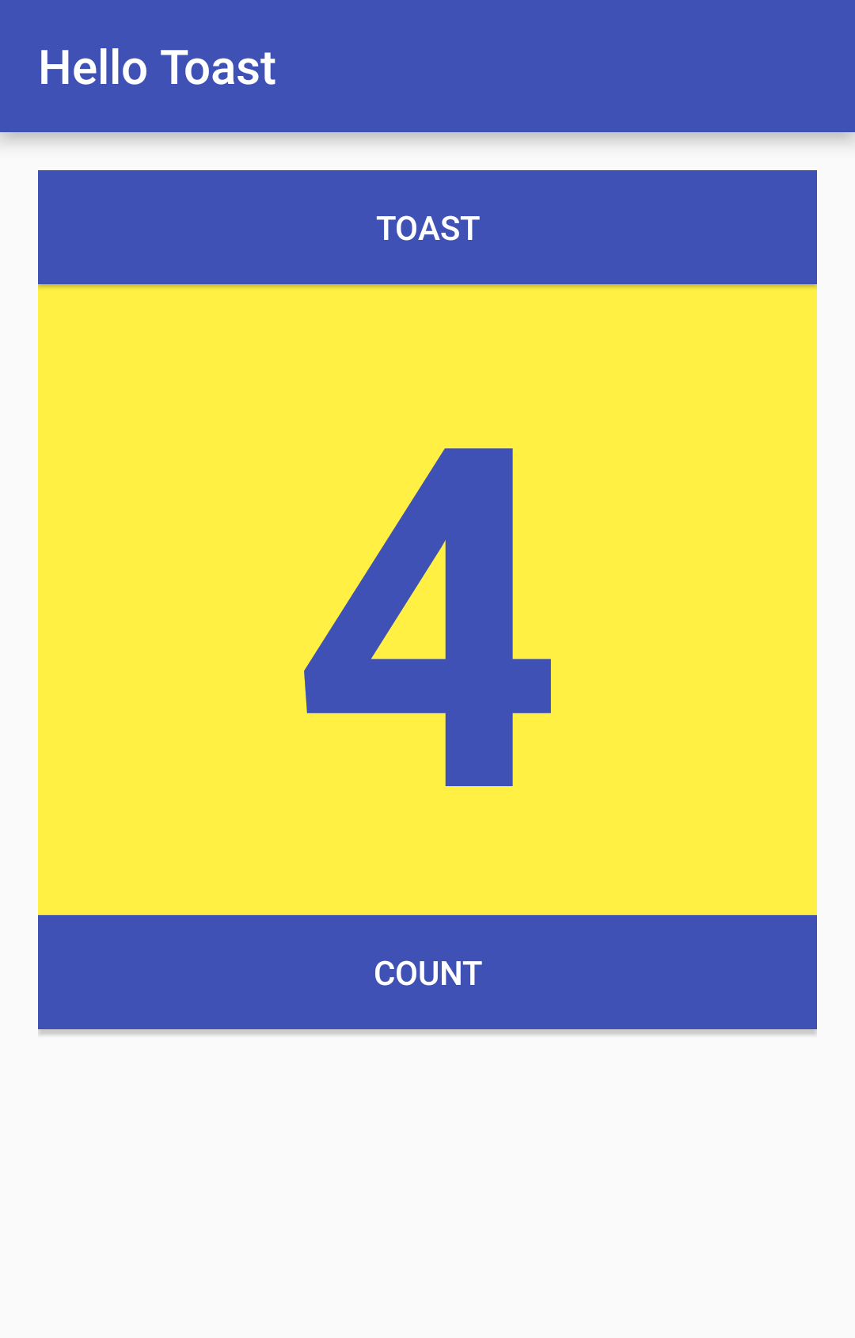
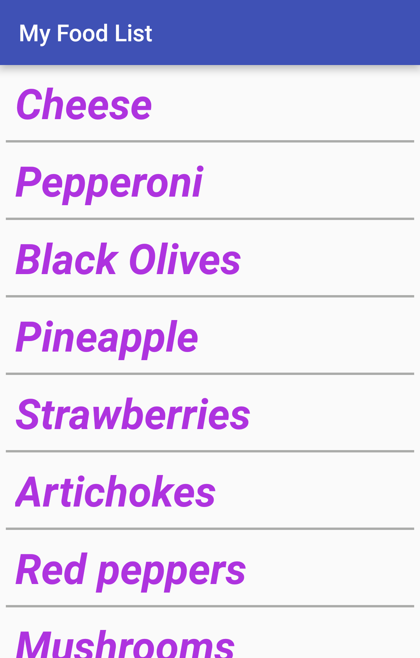
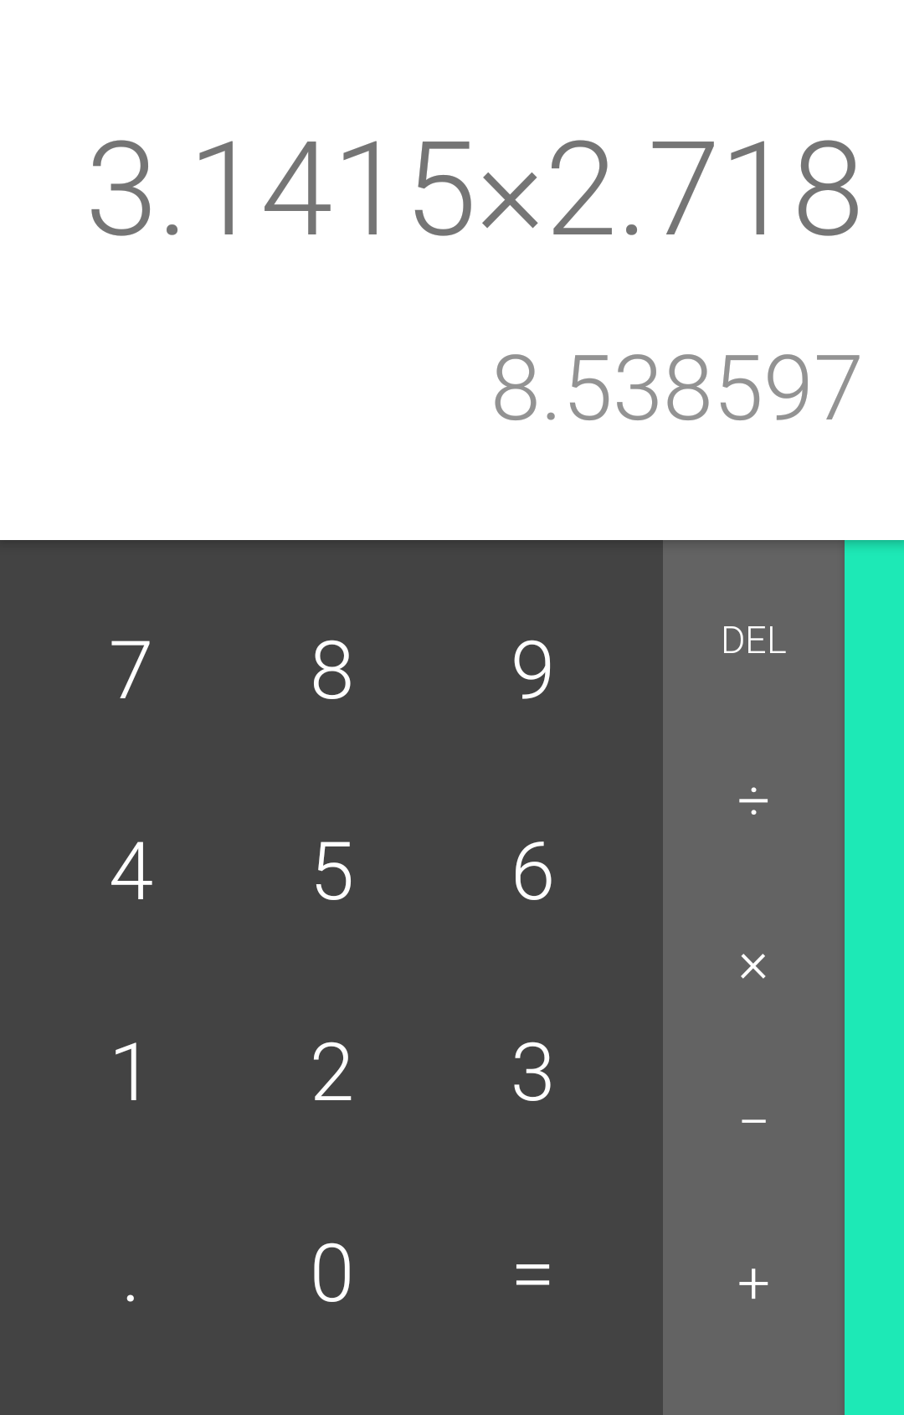
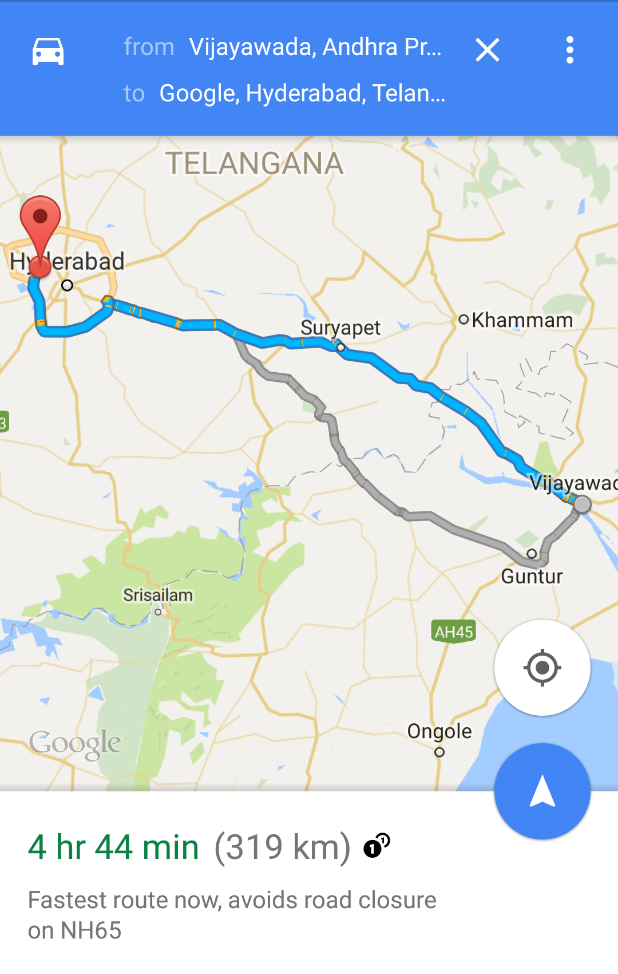
Examples of activities

Slide 7
Apps and activities
Activities are loosely tied together to make up an app
First Activity user sees is typically called "main activity"
Activities can be organized in parent-child relationships in the Android manifest to aid navigation

Slide 8
Layouts and Activities
An Activity typically has a UI layout
Layout is usually defined in one or more XML files
Activity "inflates" layout as part of being created

Slide 9
Implementing Activities

Slide 10
Implement new activities
Define layout in XML
Define Activity Java class
extends AppCompatActivity
Connect Activity with Layout
Set content view in onCreate()
Declare Activity in the Android manifest

Slide 11
Define layout in XML
<?xml version="1.0" encoding="utf-8"?>
<RelativeLayout
xmlns:android="http://schemas.android.com/apk/res/android"
android:layout_width="match_parent"
android:layout_height="match_parent">
<TextView
android:layout_width="wrap_content"
android:layout_height="wrap_content"
android:text="Let's Shop for Food!" />
</RelativeLayout>

Slide 12
2. Define Activity Java class
public class MainActivity extends AppCompatActivity {
@Override
protected void onCreate(Bundle savedInstanceState) {
super.onCreate(savedInstanceState);
}
}

Slide 13
3. Connect activity with layout
public class MainActivity extends AppCompatActivity {
@Override
protected void onCreate(Bundle savedInstanceState) {
super.onCreate(savedInstanceState);
setContentView(R.layout.activity_main);
}
}
Resource
is layout
in this XML file

Slide 14
4. Declare activity in Android manifest
<activity android:name=".MainActivity">

Slide 15
4. Declare main activity in manifest
MainActivity needs to include intent-filter to start from launcher
<activity android:name=".MainActivity">
<intent-filter>
<action android:name="android.intent.action.MAIN" />
<category android:name="android.intent.category.LAUNCHER" />
</intent-filter>
</activity>

Slide 16
Intents

Slide 17
What is an intent?
An Intent is a description of an operation to be performed.
An Intent is an object used to request an action from another app component via the Android system.
Originator
App component
Intent
Action
Android System

Slide 18
What can intents do?
Start an Activity
A button click starts a new Activity for text entry
Clicking Share opens an app that allows you to post a photo
Start an Service
Initiate downloading a file in the background
Deliver Broadcast
The system informs everybody that the phone is now charging

Slide 19
Explicit and implicit intents
Explicit Intent
Starts a specific Activity
Request tea with milk delivered by Nikita
Main activity starts the ViewShoppingCart Activity
Implicit Intent
Asks system to find an Activity that can handle this request
Find an open store that sells green tea
Clicking Share opens a chooser with a list of apps

Slide 20
Starting Activities

Slide 21
Start an Activity with an explicit intent
To start a specific Activity, use an explicit Intent
Create an Intent
Intent intent = new Intent(this, ActivityName.class);
Use the Intent to start the Activity
startActivity(intent);

Slide 22
Start an Activity with implicit intent
To ask Android to find an Activity to handle your request, use an implicit Intent
Create an Intent
Intent intent = new Intent(action, uri);
Use the Intent to start the Activity
startActivity(intent);

Slide 23
Implicit Intents - Examples
Show a web page Uri uri = Uri.parse("http://www.google.com"); Intent it = new Intent(Intent.ACTION_VIEW,uri); startActivity(it);
Dial a phone number Uri uri = Uri.parse("tel:8005551234");
Intent it = new Intent(Intent.ACTION_DIAL, uri);
startActivity(it);

Slide 24
Sending and Receiving Data

Slide 25
Two types of sending data with intents
Data—one piece of information whose data location can be represented by an URI
Extras—one or more pieces of information as a collection of key-value pairs in a Bundle

Slide 26
Sending and retrieving data
In the first (sending) Activity:
Create the Intent object
Put data or extras into that Intent
Start the new Activity with startActivity()
In the second (receiving) Activity:
Get the Intent object, the Activity was started with
Retrieve the data or extras from the Intent object

Slide 27
Putting a URI as intent data
// A web page URL
intent.setData(
Uri.parse("http://www.google.com"));
// a Sample file URI
intent.setData(
Uri.fromFile(new File("/sdcard/sample.jpg")));

Slide 28
Put information into intent extras
putExtra(String name, int value) ⇒ intent.putExtra("level", 406);
putExtra(String name, String[] value) ⇒ String[] foodList = {"Rice", "Beans", "Fruit"}; intent.putExtra("food", foodList);
putExtras(bundle); ⇒ if lots of data, first create a bundle and pass the bundle.
See documentation for all

Slide 29
Sending data to an activity with extras
public static final String EXTRA_MESSAGE_KEY = "com.example.android.twoactivities.extra.MESSAGE";
Intent intent = new Intent(this, SecondActivity.class);
String message = "Hello Activity!";
intent.putExtra(EXTRA_MESSAGE_KEY, message);
startActivity(intent);

Slide 30
Get data from intents
getData(); ⇒ Uri locationUri = intent.getData();
int getIntExtra (String name, int defaultValue) ⇒ int level = intent.getIntExtra("level", 0);
Bundle bundle = intent.getExtras(); ⇒ Get all the data at once as a bundle.
See documentation for all

Slide 31
Sending an implicit Intent

Slide 32
Sending an implicit Intent
Create an Intent for an action
Intent intent = new Intent(Intent.ACTION_CALL_BUTTON);
User has pressed Call button — start Activity that can make a call (no data is passed in or returned)
Start the Activity
if (intent.resolveActivity(getPackageManager()) != null) { startActivity(intent); }

Slide 33
Avoid exceptions and crashes
Before starting an implicit Activity, use the package manager to check that there is a package with an Activity that matches the given criteria.
Intent myIntent = new Intent(Intent.ACTION_CALL_BUTTON);
if (intent.resolveActivity(getPackageManager()) != null) { startActivity(intent); }

Slide 34
Sending an implicit Intent with data URI
Create an Intent for action
Intent intent = new Intent(Intent.ACTION_DIAL);
Provide data as a URI
intent.setData(Uri.parse("tel:8005551234"));
Start the Activity
if (intent.resolveActivity(getPackageManager()) != null) { startActivity(intent); }

Slide 35
Providing the data as URI
Create an URI from a string using Uri.parse(String uri)
Uri.parse("tel:8005551234")
Uri.parse("geo:0,0?q=brooklyn%20bridge%2C%20brooklyn%2C%20ny")
Uri.parse("http://www.android.com");
Uri documentation

Slide 36
Implicit Intent examples
Show a web page Uri uri = Uri.parse("http://www.google.com"); Intent it = new Intent(Intent.ACTION_VIEW,uri); startActivity(it);
Dial a phone number Uri uri = Uri.parse("tel:8005551234");
Intent it = new Intent(Intent.ACTION_DIAL, uri);
startActivity(it);

Slide 37
Sending an implicit Intent with extras
Create an Intent for an action
Intent intent = new Intent(Intent.ACTION_WEB_SEARCH);
Put extras
String query = edittext.getText().toString();
intent.putExtra(SearchManager.QUERY, query));
Start the Activity
if (intent.resolveActivity(getPackageManager()) != null) { startActivity(intent); }

Slide 38
Category
Additional information about the kind of component to handle the intent.
CATEGORY_OPENABLE
Only allow URIs of files that are openable
CATEGORY_BROWSABLE
Only an Activity that can start a web browser to display data referenced by the URI

Slide 39
Sending an implicit Intent with type and category
Create an Intent for an action
Intent intent = new Intent(Intent.ACTION_CREATE_DOCUMENT);
Set mime type and category for additional information
intent.setType("application/pdf"); // set MIME type
intent.addCategory(Intent.CATEGORY_OPENABLE);
continued on next slide...

Slide 40
Sending an implicit Intent with type and category
3. Start the Activity
if (intent.resolveActivity(getPackageManager()) != null) { startActivityForResult(myIntent,ACTIVITY_REQUEST_CREATE_FILE); }
4. Process returned content URI in onActivityResult()

Slide 41
Receiving an Implicit Intent

Slide 42
Register your app to receive an Intent
Declare one or more Intent filters for the Activity in AndroidManifest.xml
Filter announces ability of Activity to accept an implicit Intent
Filter puts conditions on the Intent that the Activity accepts

Slide 43
Intent filter in AndroidManifest.xml
<activity android:name="ShareActivity"> <intent-filter> <action android:name="android.intent.action.SEND"/> <category android:name="android.intent.category.DEFAULT"/> <data android:mimeType="text/plain"/> </intent-filter>
</activity>

Slide 44
Intent filters: action and category
action — Match one or more action constants
android.intent.action.VIEW — matches any Intent with ACTION_VIEW
android.intent.action.SEND — matches any Intent with ACTION_SEND
category — additional information (list of categories)
android.intent.category.BROWSABLE—can be started by web browser
android.intent.category.LAUNCHER—Show activity as launcher icon

Slide 45
END

